Slide 1
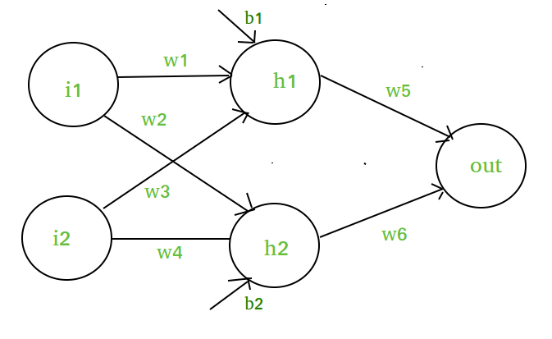
What is an activation function and why to use them?
Definition of activation function:- Activation function decides, whether a neuron should be activated or not by calculating weighted sum and further adding bias with it. The purpose of the activation function is to introduce non-linearity into the output of a neuron.
doesn’t matter how many hidden layer we attach in neural net, all layers will behave same way because the composition of two linear function is a linear function itself.
Neuron can not learn with just a linear function attached to it. A non-linear activation function will let it learn as per the difference w.r.t error.

Slide 2
Activation Function in Neural networks
If we do not apply a Activation function then the output signal would simply be a simple linear function.A linear function is just a polynomial of one degree.
Now, a linear equation is easy to solve but they are limited in their complexity and have less power to learn complex functional mappings from data.
A Neural Network without Activation function would simply be a Linear regression Model, which has limited power and does not performs good most of the times.
We want our Neural Network to not just learn and compute a linear function but something more complicated than that.
Also without activation function our Neural network would not be able to learn and model other complicated kinds of data such as images, videos , audio , speech etc.

Slide 3
Linear Function :-
Equation : Linear function has the equation similar to as of a straight line i.e. y = ax
No matter how many layers we have, if all are linear in nature, the final activation function of last layer is nothing but just a linear function of the input of first layer.
Range : -inf to +inf
Uses : Linear activation function is used at just one place i.e. output layer.
Issues : If we will differentiate linear function to bring non-linearity, result will no more depend on input “x” and function will become constant, it won’t introduce any ground-breaking behavior to our algorithm.
For example : Calculation of price of a house is a regression problem. House price may have any big/small value, so we can apply linear activation at output layer. Even in this case neural net must have any non-linear function at hidden layers.

Slide 4
Activation Function in Neural networks
So why do we need Non-Linearities?
Non-linear functions are those which have degree more than one and they have a curvature when we plot a Non-Linear function.
Now we need a Neural Network Model to learn and represent almost anything and any arbitrary complex function which maps inputs to outputs.
Neural-Networks are considered Universal Function Approximators. It means that they can compute and learn any function at all. Almost any process we can think of can be represented as a functional computation in Neural Networks.
Also another important feature of a Activation function is that it should be differentiable. We need it to be this way so as to perform backpropogation optimization strategy while propogating backwards in the network to compute gradients of Error(loss) with respect to Weights and then accordingly optimize weights using Gradient descend or any other Optimization technique to reduce Error.

Slide 5
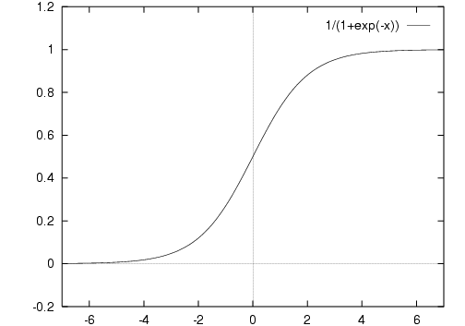
Most popular types of Activation functions
Sigmoid or Logistic
Tanh — Hyperbolic tangent
ReLu -Rectified linear units
Sigmoid Activation function: It is a activation function of form f(x) = 1 / 1 + exp(-x) . Its Range is between 0 and 1. It is a S — shaped curve.
Nature : Non-linear. Notice that X values lies between -2 to 2, Y values are very steep. This means, small changes in x would also bring about large changes in the value of Y.
Value Range : 0 to 1
Uses : Usually used in output layer of a binary classification, where result is either 0 or 1, as value for sigmoid function lies between 0 and 1 only so, result can be predicted easily to be 1 if value is greater than 0.5 and 0 otherwise.

Slide 6
It is easy to understand and apply but it has major reasons which have made it fall out of popularity -
Vanishing gradient problem
Secondly , its output isn’t zero centered. It makes the gradient updates go too far in different directions. 0 < output < 1, and it makes optimization harder.
Sigmoids saturate and kill gradients.
Sigmoids have slow convergence.

Slide 7
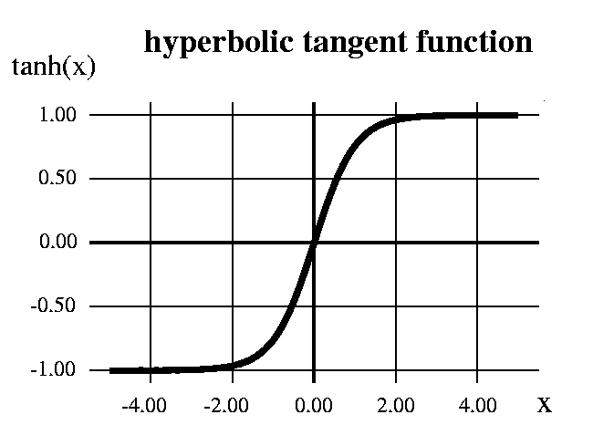
Tangent Hyperbolic function
The activation that works almost always better than sigmoid function is Tanh function also knows as Tangent Hyperbolic function.
It’s actually mathematically shifted version of the sigmoid function. Both are similar and can be derived from each other.
Equation :-f(x) = tanh(x) = 2/(1 + e^{-2x}) - 1 OR tanh(x) = 2 * sigmoid(2x) – 1
Value Range :- -1 to +1
Nature :- non-linear
Uses :- Usually used in hidden layers of a neural network as it’s values lies between -1 to 1 hence the mean for the hidden layer comes out be 0 or very close to it, hence helps in centering the data by bringing mean close to 0. This makes learning for the next layer much easier.
But still it suffers from Vanishing gradient problem.
Then how do we deal and rectify the vanishing gradient problem ?

Slide 8
RELU :- Stands for Rectified linear unit. It is the most widely used activation function. Chiefly implemented in hidden layers of Neural network.
Equation :- A(x) = max(0,x). It gives an output x if x is positive and 0 otherwise.
Value Range :- [0, inf)
Nature :- non-linear, which means we can easily backpropagate the errors and have multiple layers of neurons being activated by the ReLU function.
Uses :- ReLu is less computationally expensive than tanh and sigmoid because it involves simpler mathematical operations. At a time only a few neurons are activated making the network sparse making it efficient and easy for computation.

Slide 9
Activation Function in Neural networks
ReLu- Rectified Linear units : It has become very popular in the past couple of years.
It was recently proved that it had 6 times improvement in convergence from Tanh function. It’s just R(x) = max(0,x) i.e if x < 0 , R(x) = 0 and if x >= 0 , R(x) = x.
A lot of times in Machine learning and computer science we notice that most simple and consistent techniques and methods are only preferred and are best.
Hence it avoids and rectifies vanishing gradient problem . Almost all deep learning Models use ReLu nowadays.
But its limitation is that it should only be used within Hidden layers of a Neural Network Model.
Hence for output layers we should use a Softmax function for a Classification problem to compute the probabilites for the classes , and for a regression problem it should simply use a linear function.

Slide 10
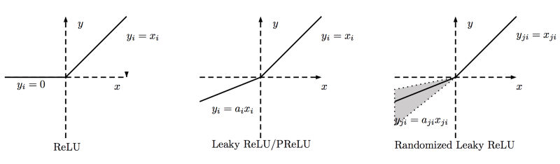
Activation Function in Neural networks
Another problem with ReLu is that some gradients can be fragile during training and can die.
It can cause a weight update which will makes it never activate on any data point again.
Simply saying that ReLu could result in Dead Neurons.
To fix this problem another modification was introduced called Leaky ReLu to fix the problem of dying neurons. It introduces a small slope to keep the updates alive.
another variant made form both ReLu and Leaky ReLu called Maxout function .

Slide 11
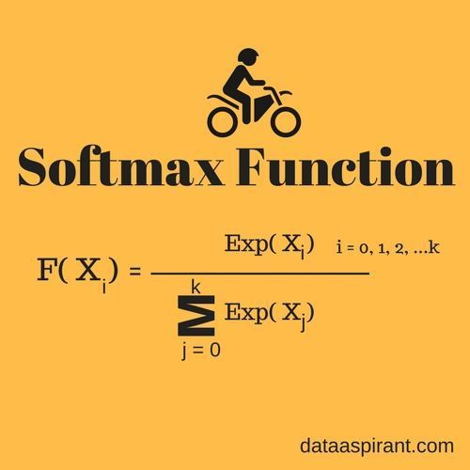
Activation Function in Neural networks
Softmax Function :- The softmax function is also a type of sigmoid function but is handy when we are trying to handle classification problems.
Nature :- non-linear
Uses :- Usually used when trying to handle multiple classes. The softmax function would squeeze the outputs for each class between 0 and 1 and would also divide by the sum of the outputs.
Ouput:- The softmax function is ideally used in the output layer of the classifier where we are actually trying to attain the probabilities to define the class of each input.
Softmax function calculates the probabilities distribution of the event over ‘n’ different events. In general way of saying, this function will calculate the probabilities of each target class over all possible target classes. Later the calculated probabilities will be helpful for determining the target class for the given inputs.

Slide 12
Activation Function in Neural networks
 | Softmax Function | Sigmoid Function
1 | Used for multi-classification in logistic regression model. | Used for binary classification in logistic regression model.
2 | The probabilities sum will be 1 | The probabilities sum need not be 1.
3 | Used in the different layers of neural networks. | Used as activation function while building neural networks.
4 | The high value will have the higher probability than other values. | The high value will have the high probability but not the higher probability.

